Slide 1


Putting the Fast in fast.ai – Machine Learning Models in 15mins
Akanksha Malik
@akankshamalik96

Slide 2
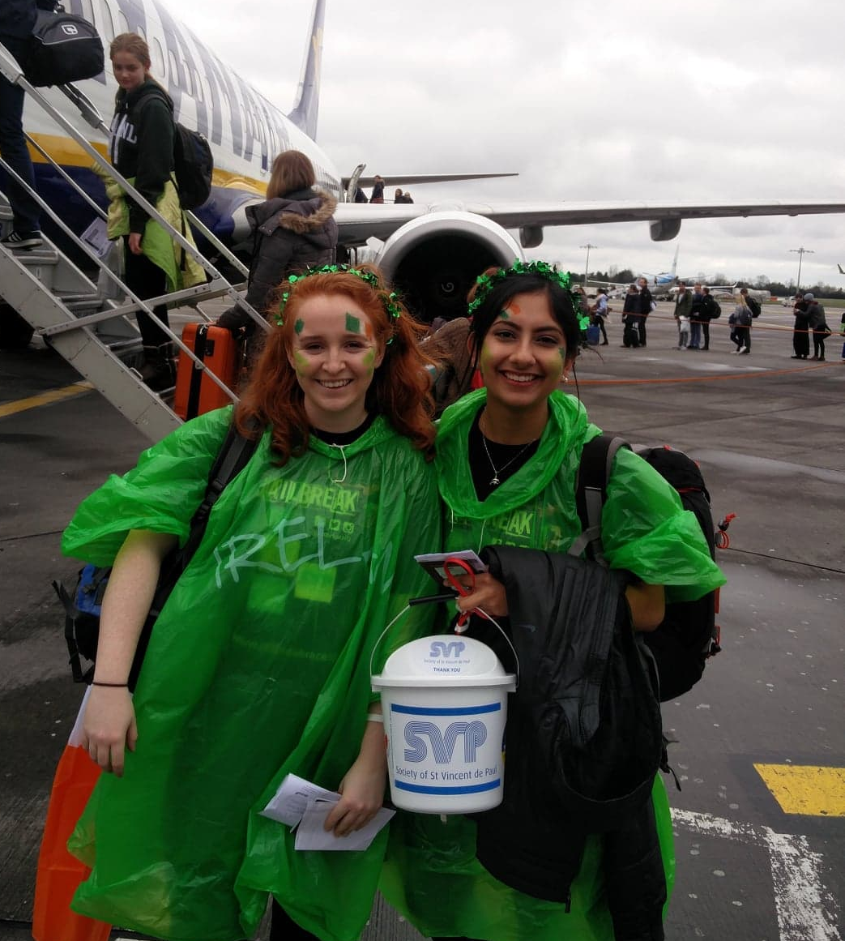
A little bit about me…

Slide 3
Artificial Intelligence
Machine Learning
?
Machine Learning
Deep Learning
Notes:
AI: a program that can sense, reason, act and adapt
ML: algorithms whose performance improve as they are exposed to more data over time
DL: subset of machine learning in which multilayered neural networks learn from vast amounts of data

Slide 4
fast.ai

Slide 5


Transfer Learning
Notes:
AI: a program that can sense, reason, act and adapt
ML: algorithms whose performance improve as they are exposed to more data over time
DL: subset of machine learning in which multilayered neural networks learn from vast amounts of data

Slide 6
fast.ai
Natural Language Processing
Computer Vision

Slide 7
Setup
Data Science VM
Jupyter Notebooks
Notes:
Logos/written out

Slide 8
Virtual Machine
http://aka.ms/dsvm/fastai
Notes:
Logos/written out

Slide 9
Get the Data!
urls = Array.from(document.querySelectorAll('.rg_di. rg_meta')).map(el=>JSON.parse(el.textContent).ou);
copy(urls.join('\n'));
Notes:
Logos/written out

Slide 10
Thank You for Listening!
Any questions?
https://github.com/akankshamalik/ whatbearisit

Slide 11
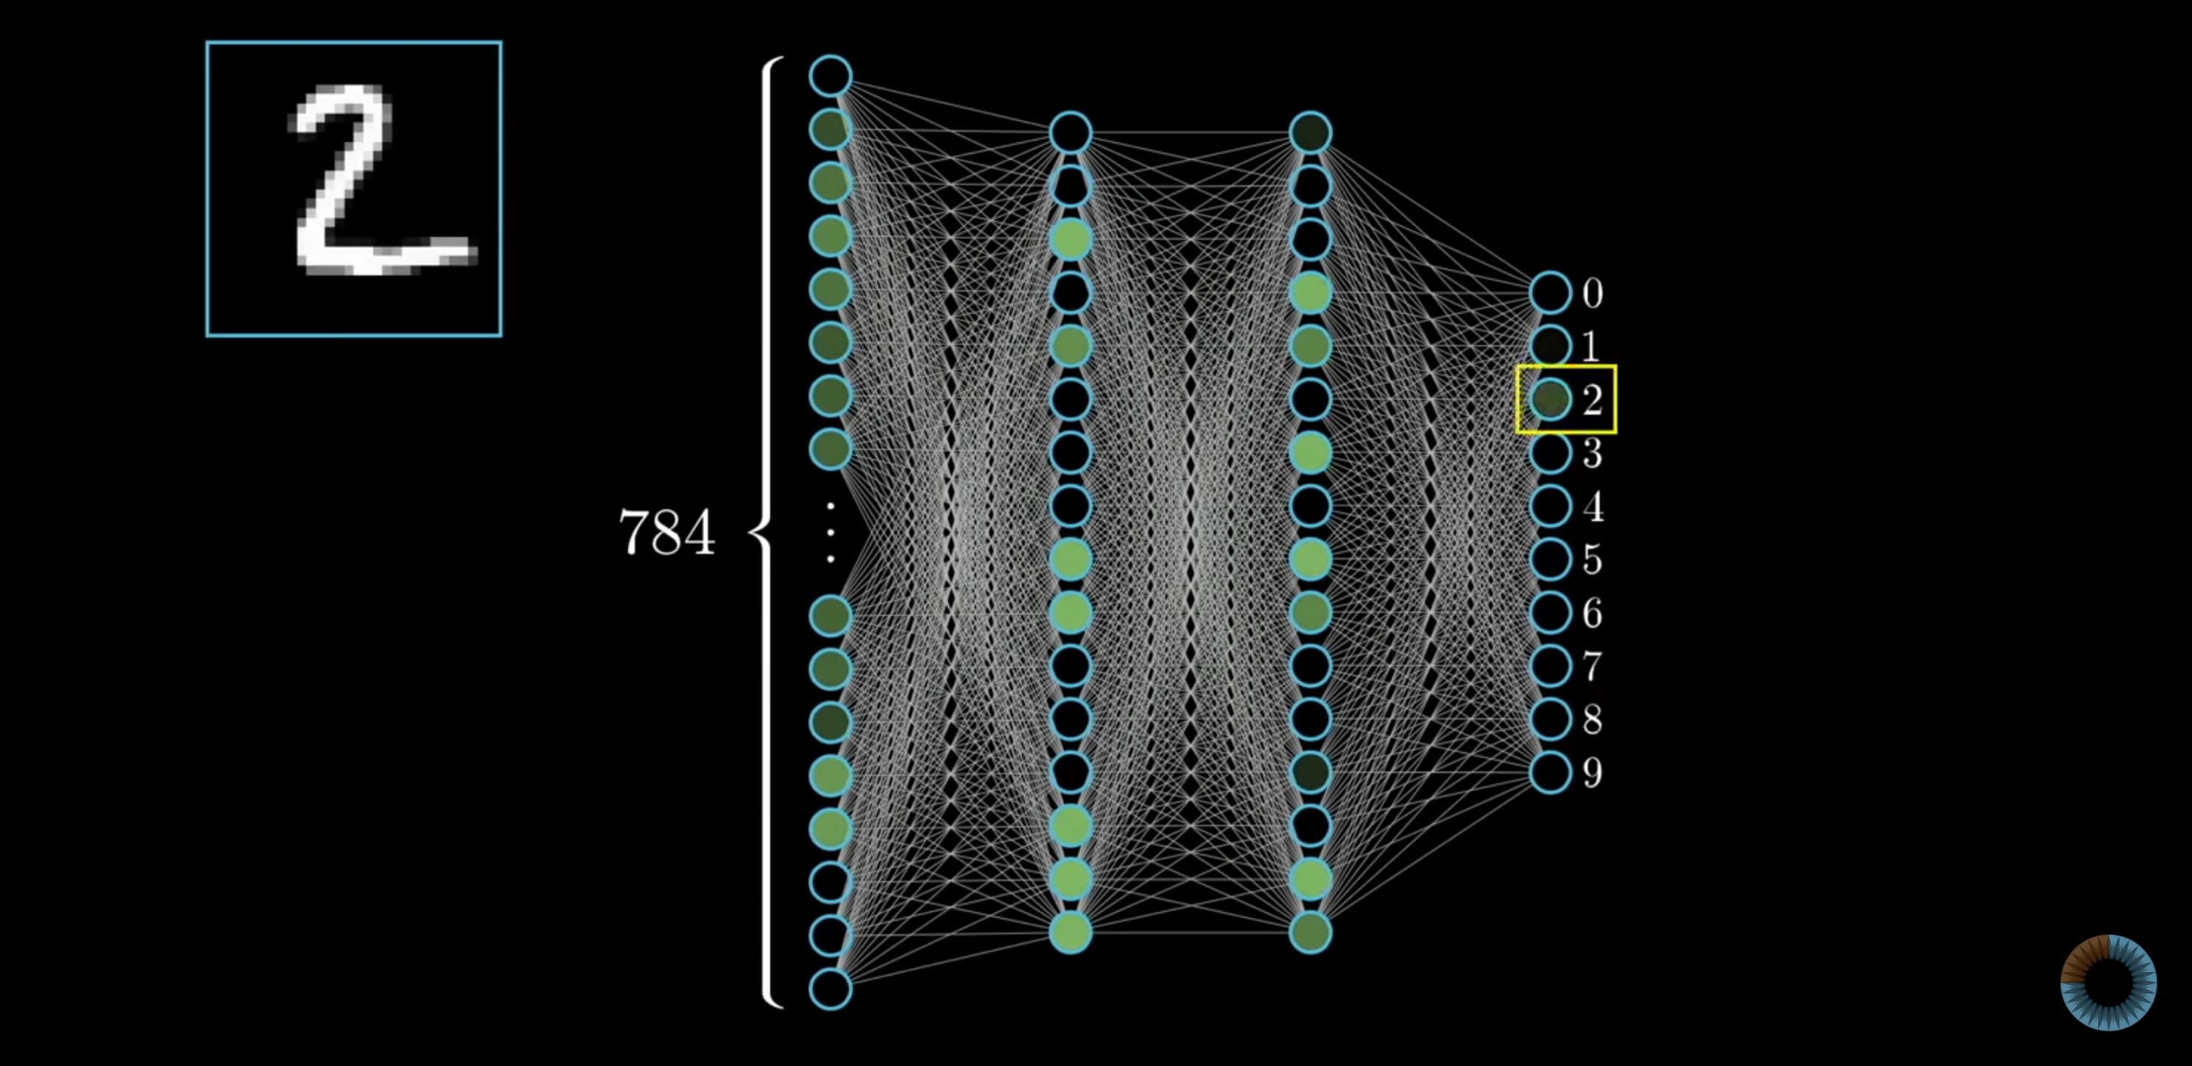
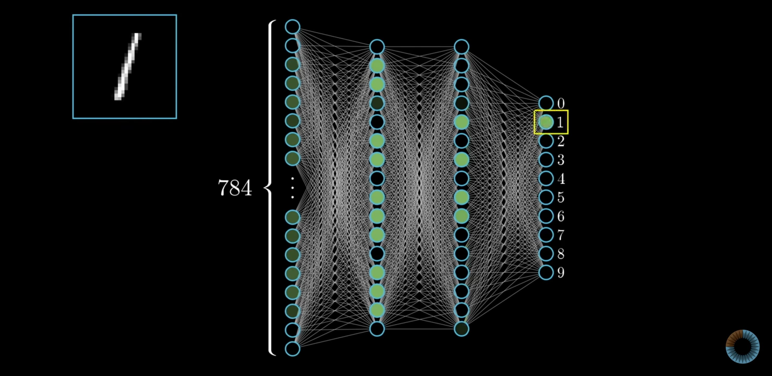
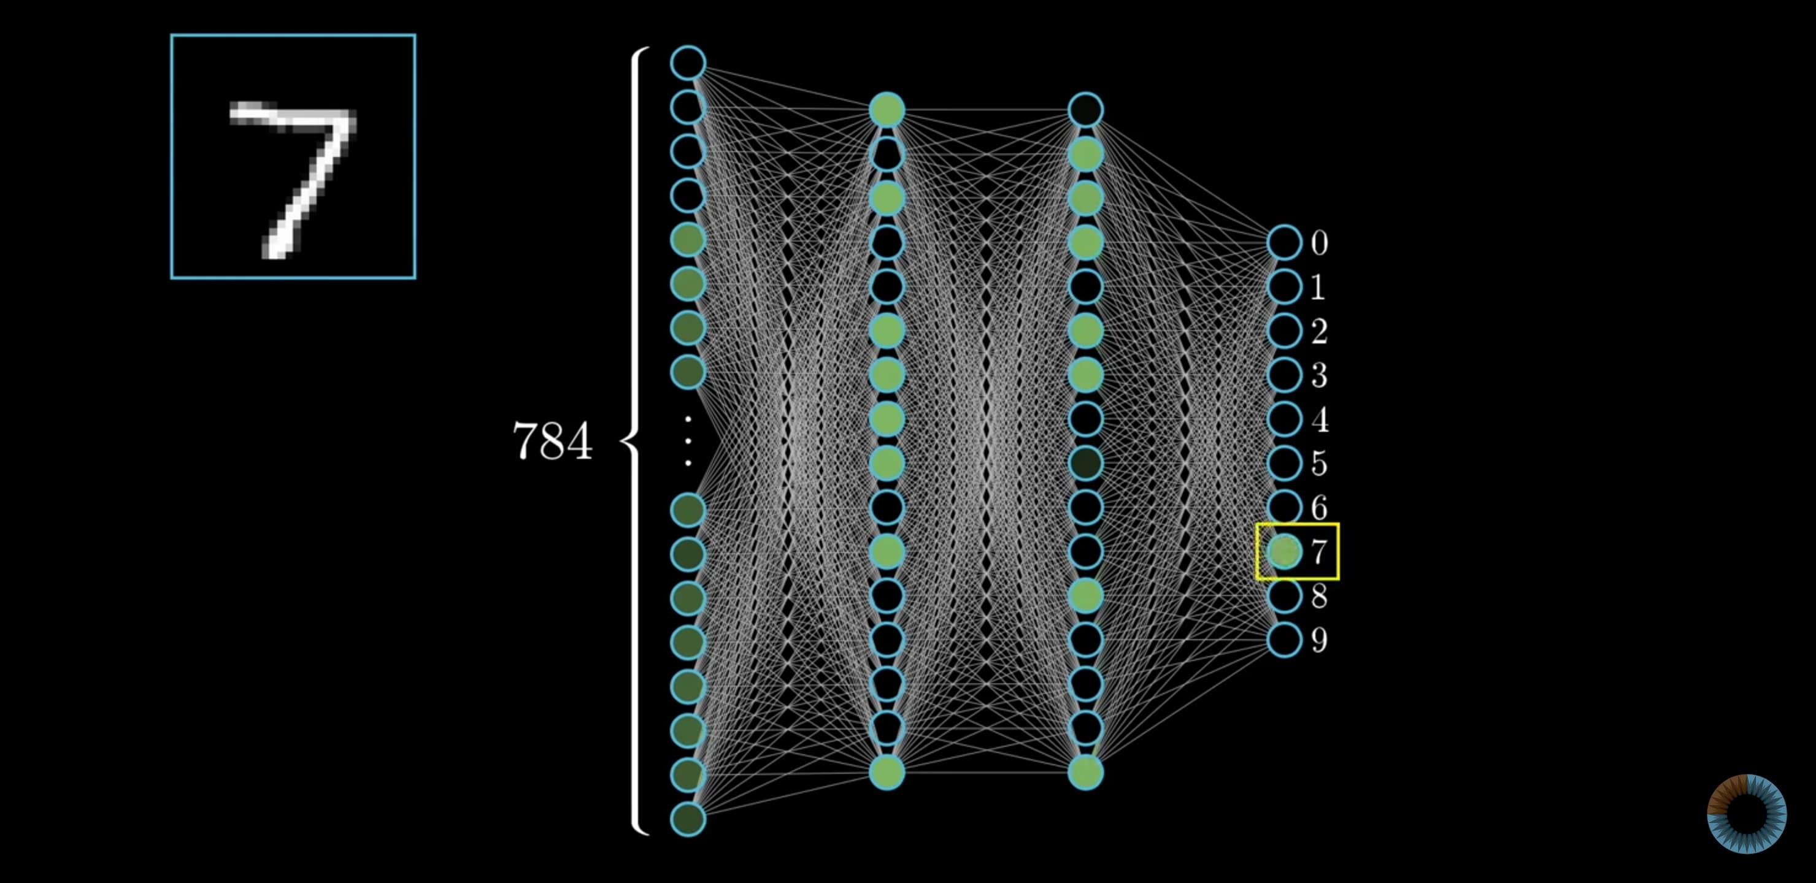
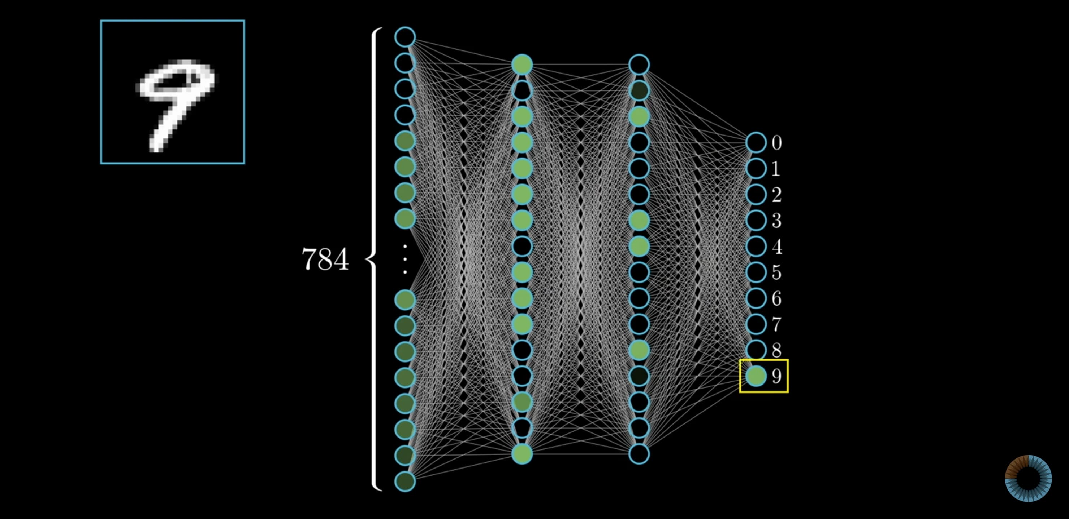

Slide 12
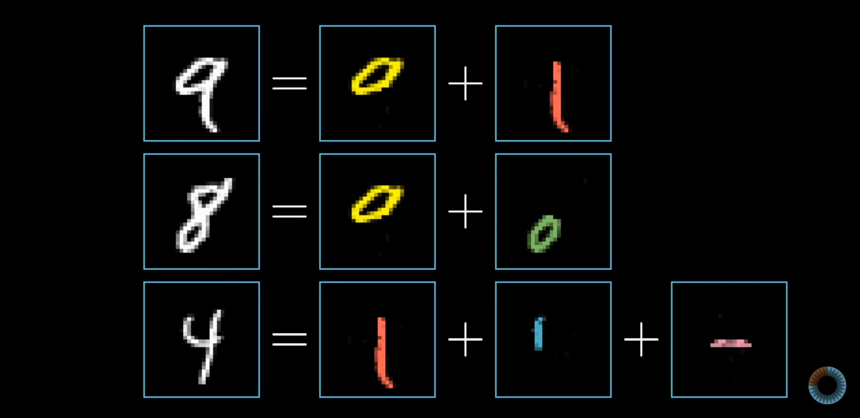

Slide 13
